Slide 1
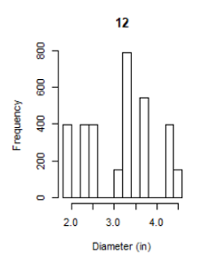
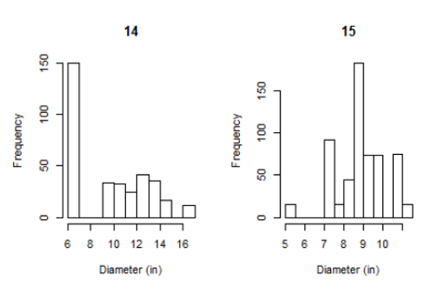
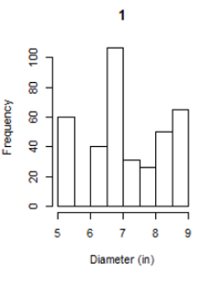
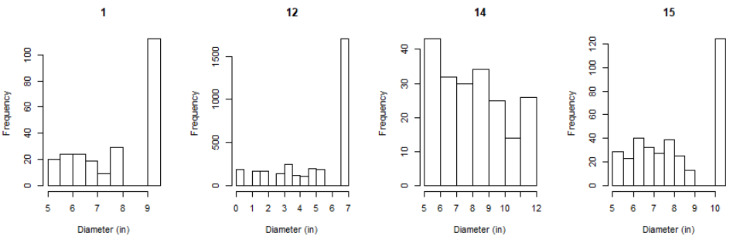

Slide 2
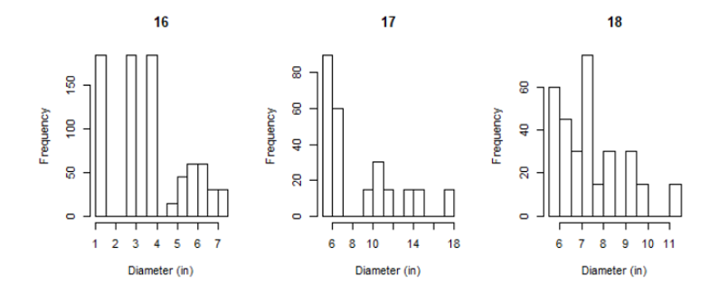
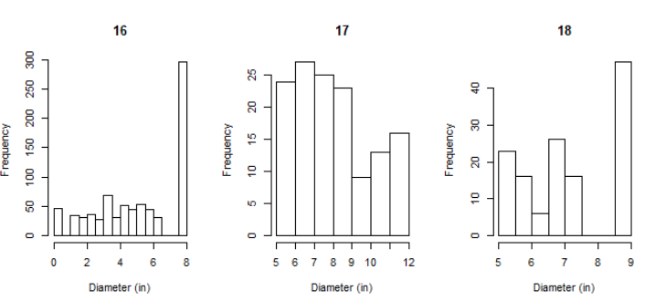

Slide 3
Growth rate before and after parameter correction
10(-1.2975+ 0.1872temp - 0.0044temp2 - 0.2243aridity) * 0.3536age^{-0.6464}
10(-2.0007+ 0.1872temp - 0.0044temp2 - 0.2243aridity) * 0.81335age^{-0.18665}

Slide 4
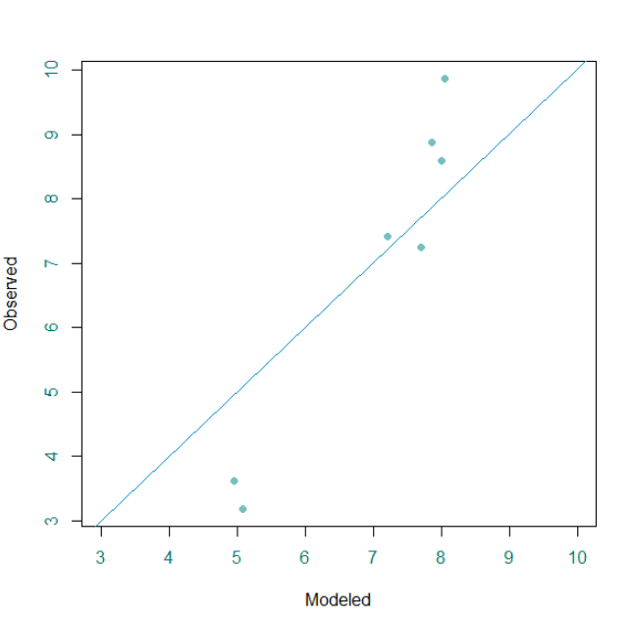
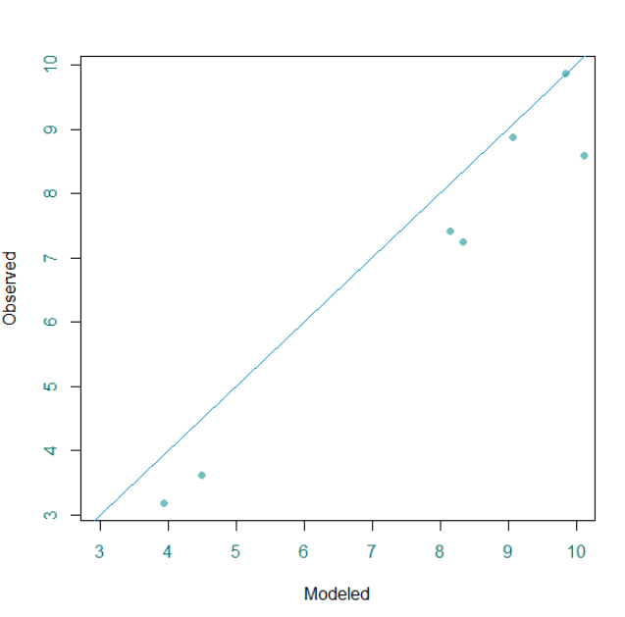

Slide 5
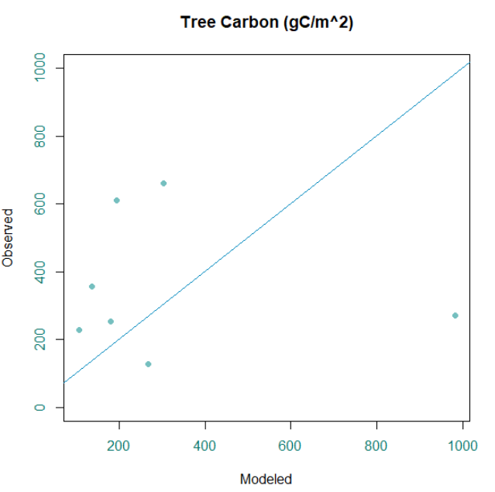
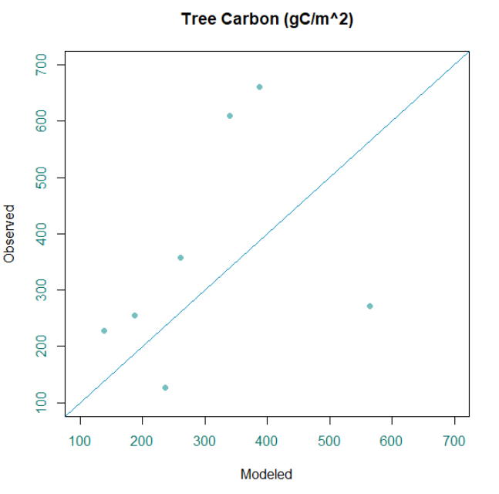

Slide 6
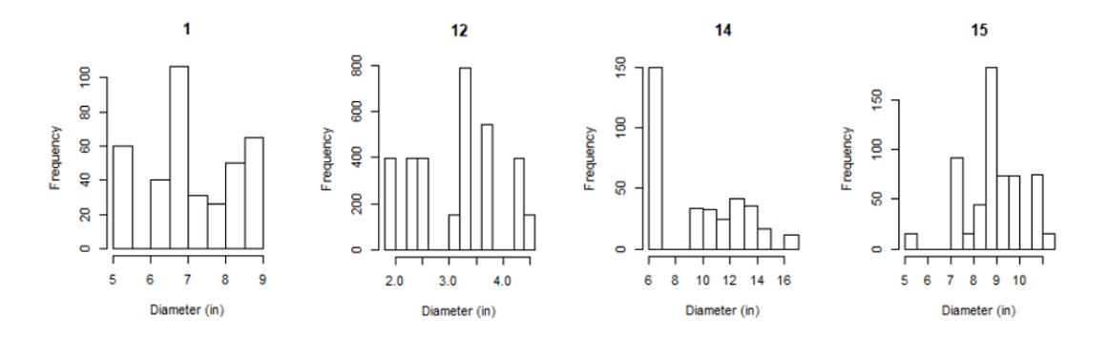
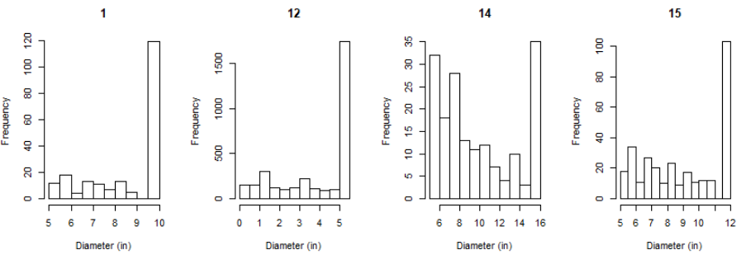

Slide 7
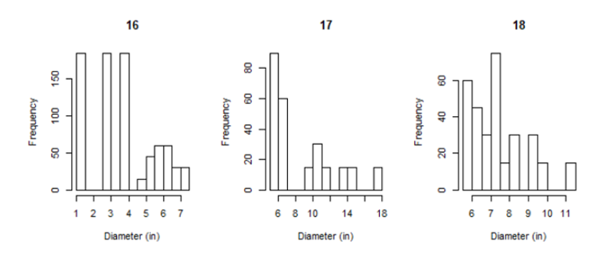
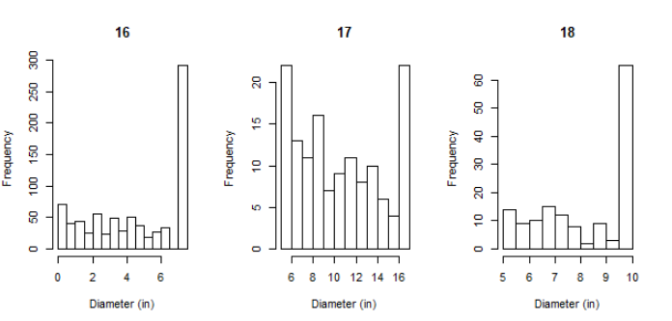

Slide 8
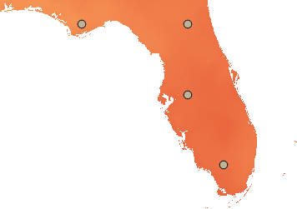
Grams of Carbon stored in living biomass in year 2100
Site | Mean gC/m² | SD
Panhandle | 644.46 | 70.42
North | 816.54 | 52.64
Central | 920.45 | 77.13
South | 817.92 | 66.85

Slide 9
